Slide 1
Simple harmonic motion

Slide 2
Trigonometric derivatives

Slide 3
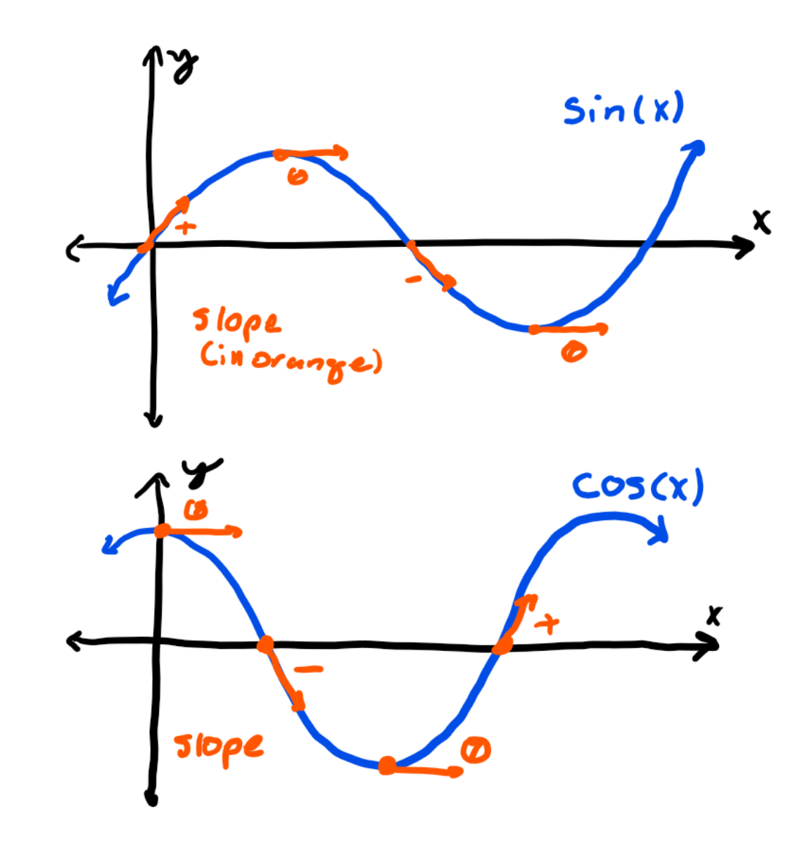
Slopes of sine and cosine
The slope of the sine graph starts positive, goes toward zero, then goes negative, then rises back to zero.
The cosine function also follows the same pattern: in fact, the derivative of sine is cosine.
However, the slope of the cosine function first starts zero, then falls, then rises, which is what negative sine looks like, so the derivative of cosine is actually negative sine.

Slide 4
Circular motion

Slide 5
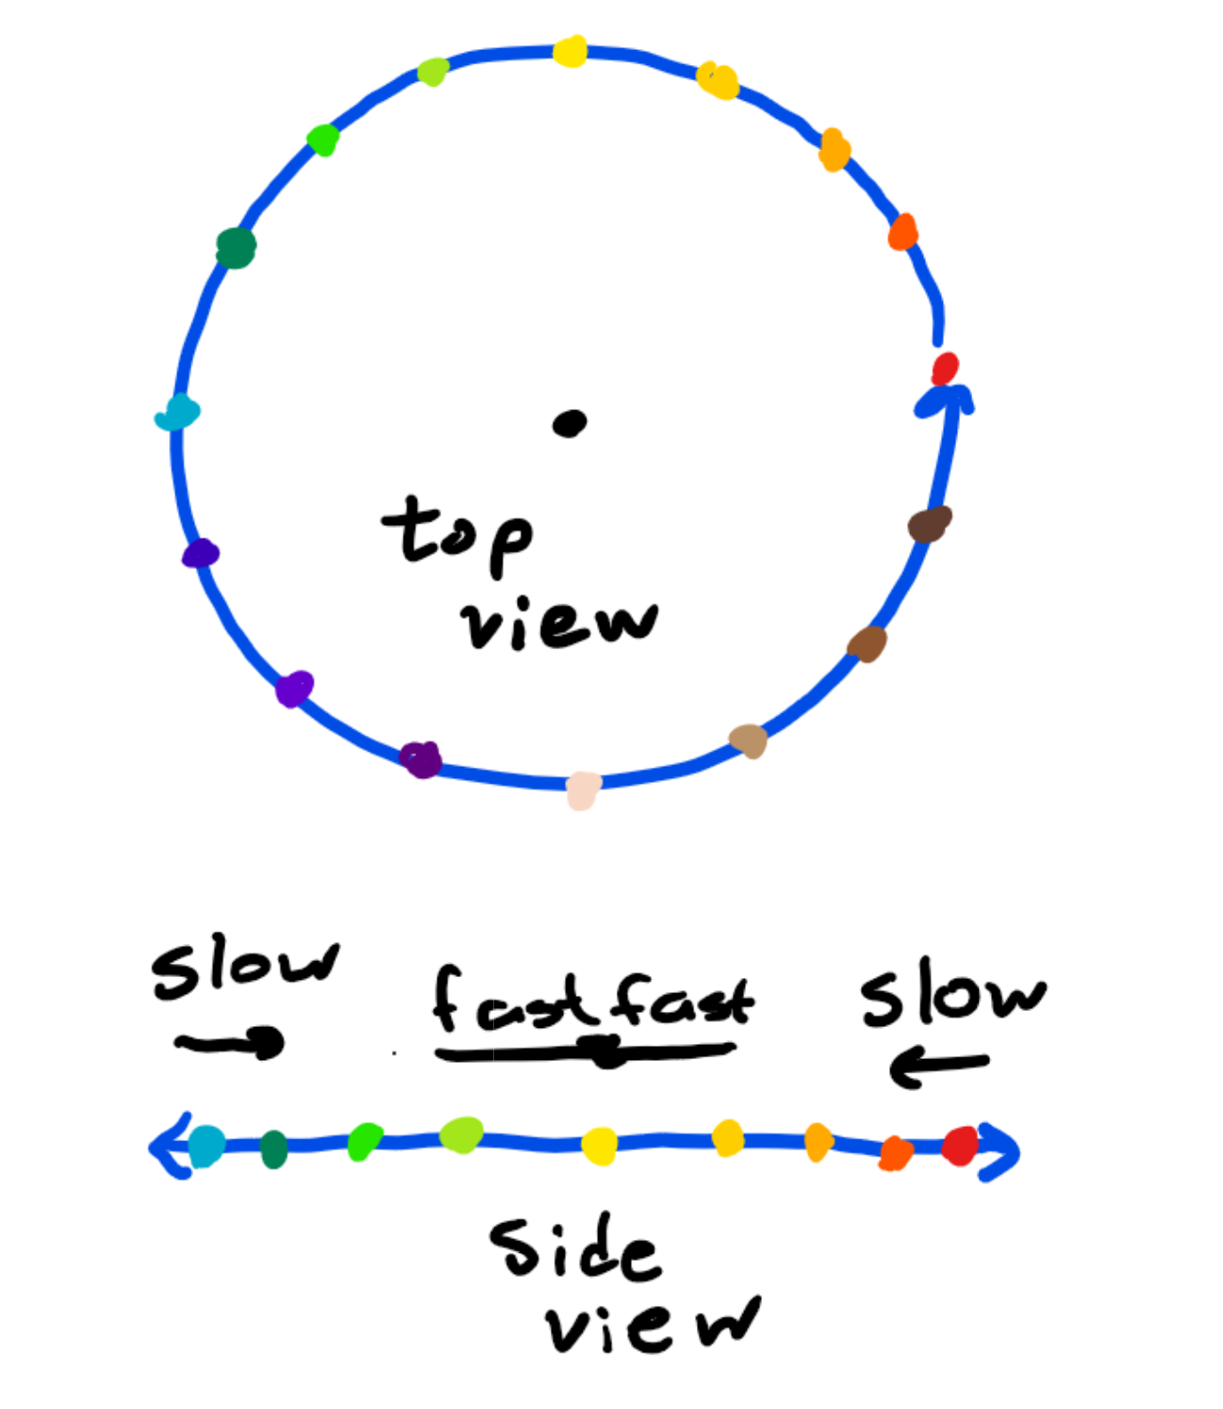
What it looks like
Circular motion is just an object travelling in a circle at a constant angular velocity.
What would it look like if we saw it from the side?
In the middle it would travel slow, but on the outside it would travel fast.
This “side view” is just the horizontal portion of the circular potion.

Slide 6
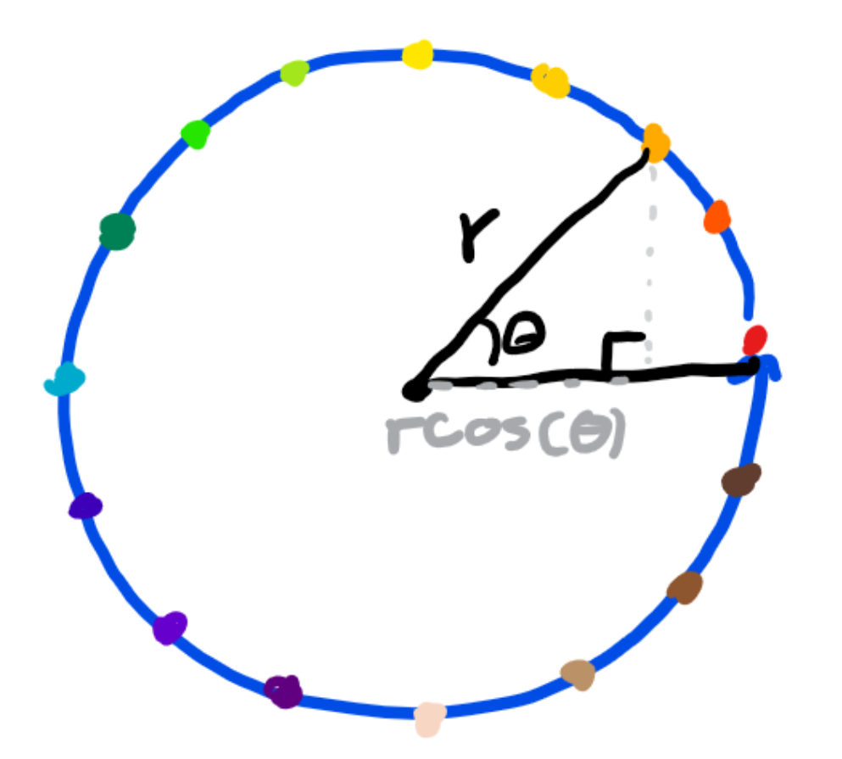
Horizontal position
We can write an equation for the horizontal position of the object.
Since the horizontal portion of the unit circle is cos(θ), the horizontal portion of a circle of radius r is rcos(θ).
Note that rcos(θ) is maximized at r and minimized at -r since cos(θ) ranges from -1 to 1.

Slide 7
Spring SHM

Slide 8
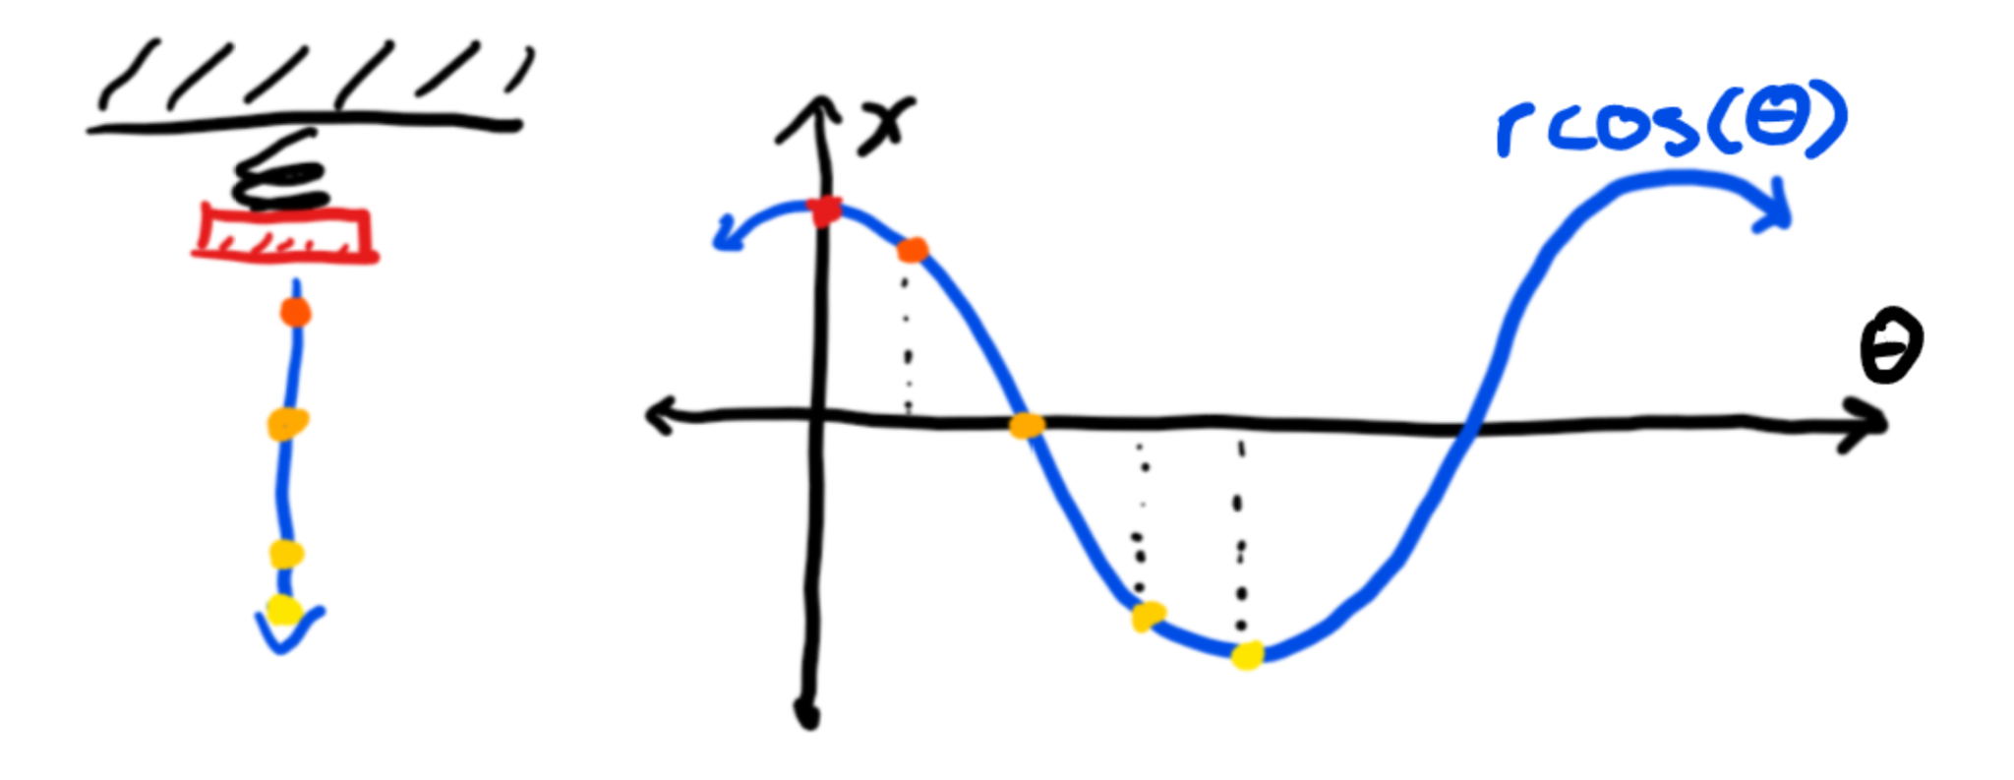
Graphs
If stretch out a spring and watch it oscillate, we’ll see it bounce up and down over time.
If we plot it against time we’ll notice it looks exactly like a cosine graph.

Slide 9
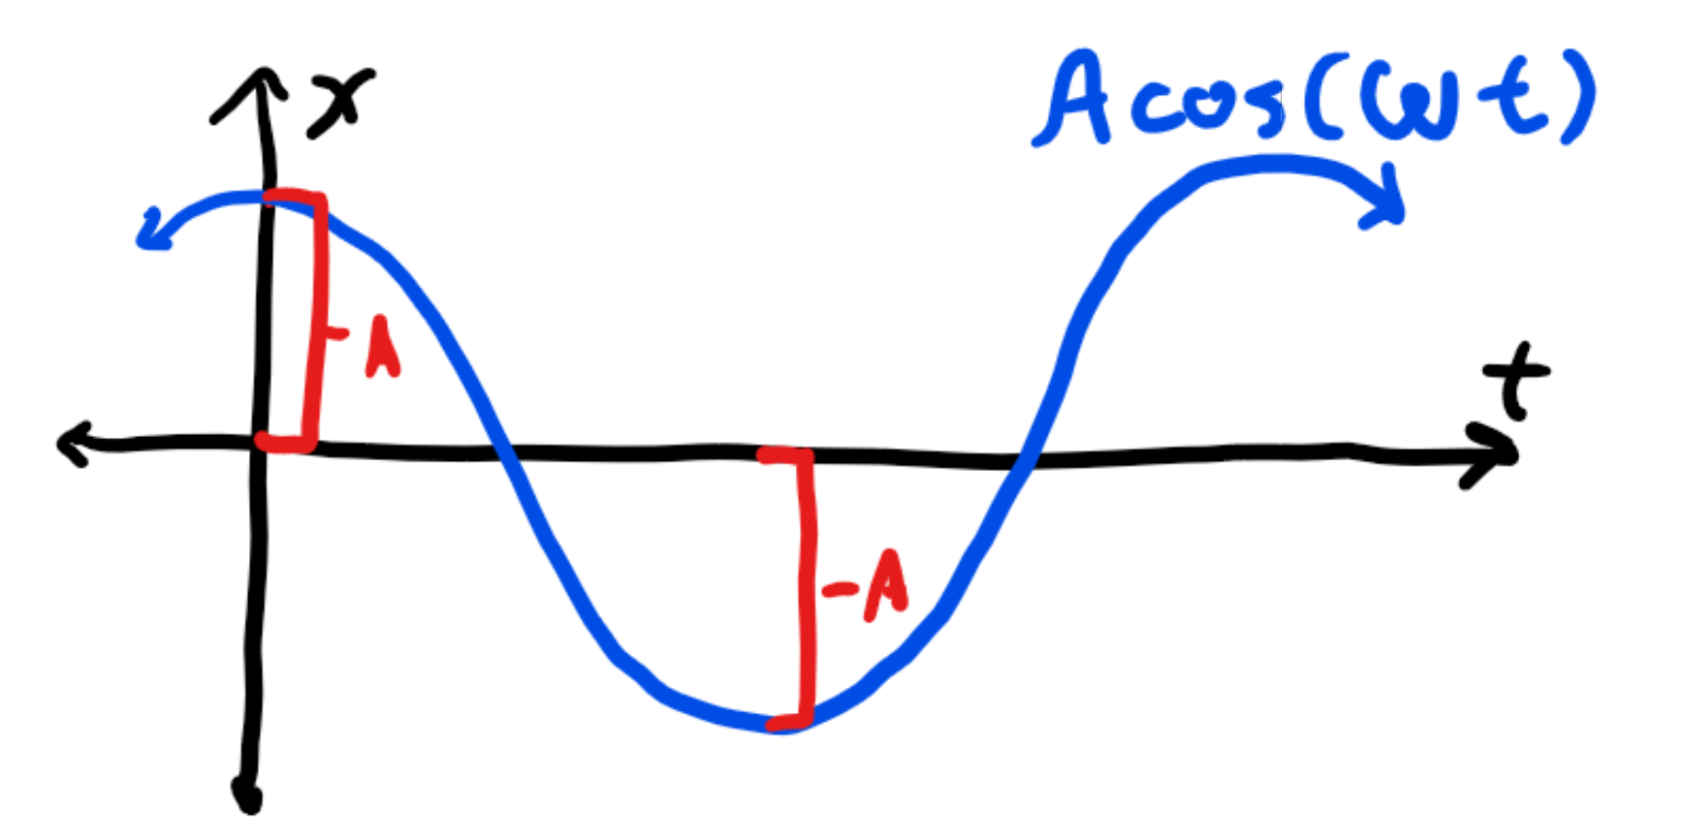
Definitions
Amplitude: how far an object travels from equilibrium. On the graph, these are the highest/lowest positions and is symbolized by a letter A.
We know rcos(θ) has highest and lowest point with magnitude r, which is what we defined amplitude, and we know θ = ωt, so rcos(θ) can be rewritten as the equation Acos(ωt).

Slide 10
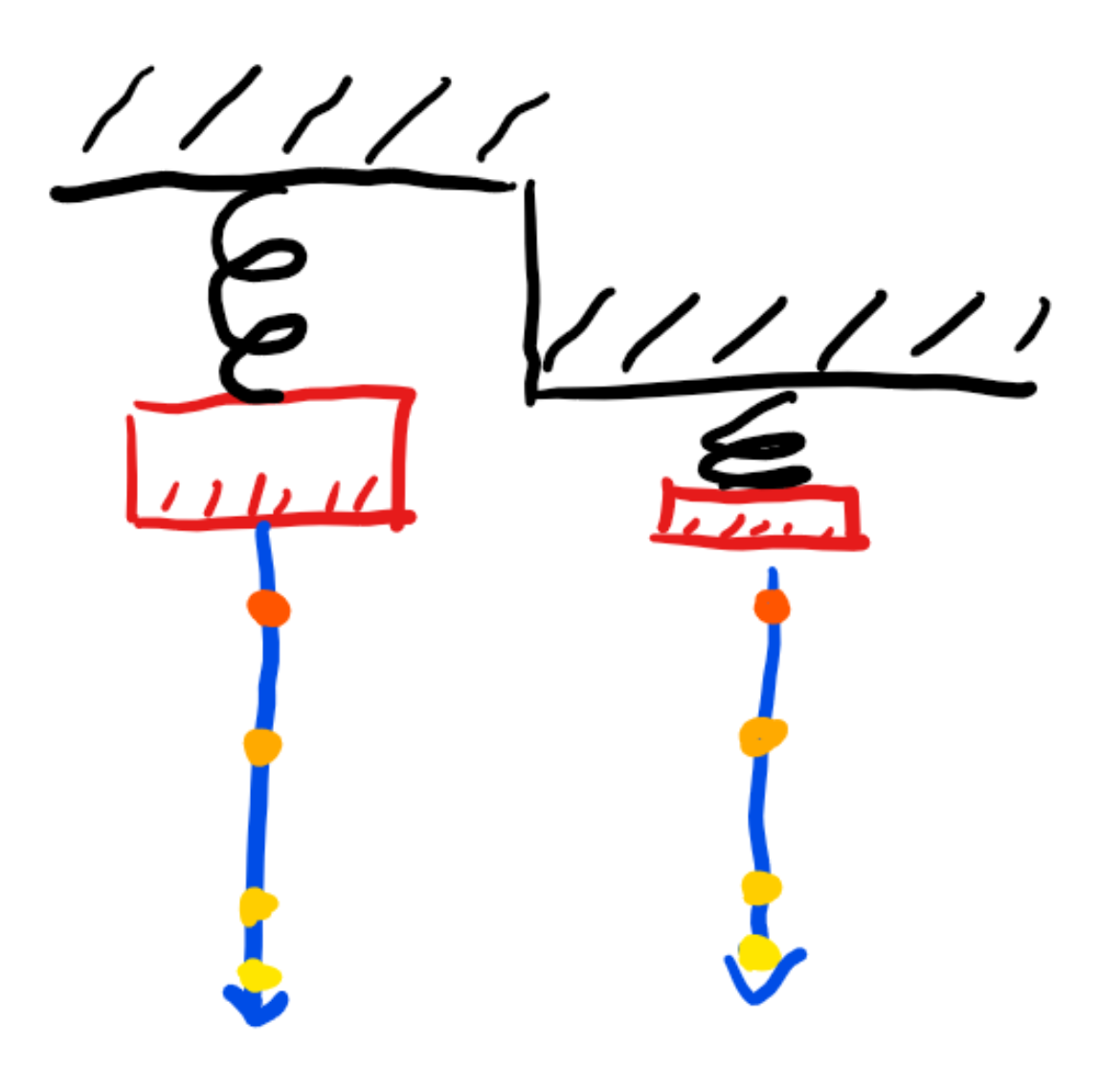
Gravity
Since F = -kx increases linearly with distance displaced, if a mass hanging from it causes the spring to reach a new equilibrium, as long as the spring follows Hooke’s law, the spring will still follow Hooke’s law, just with the new equilibrium as, well, the equilibrium.

Slide 11
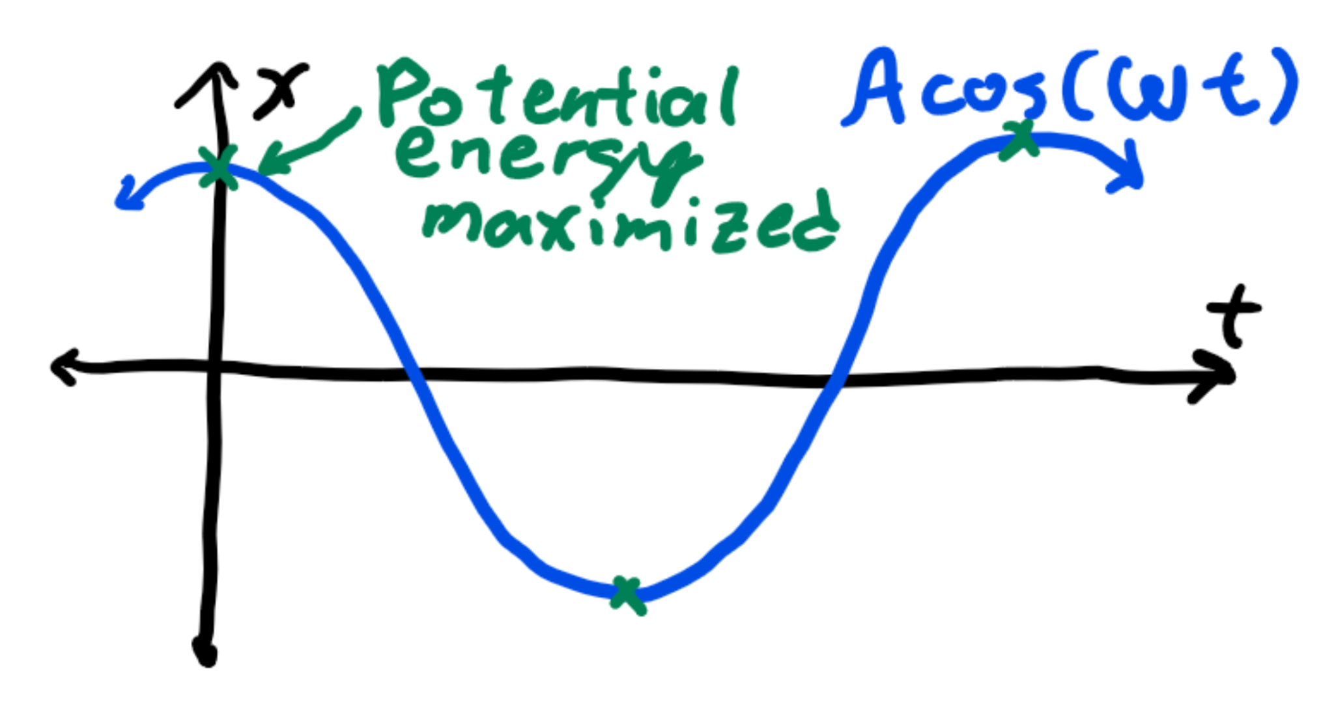
Position
The position function can be written as x(t) = Acos(ωt).
The function x(t) is maximized at A, so by Hooke’s law, the maximum force on the spring is F = -kx = -kA.
The maximum spring potential energy is thus ½ kx² = ½ kA².

Slide 12
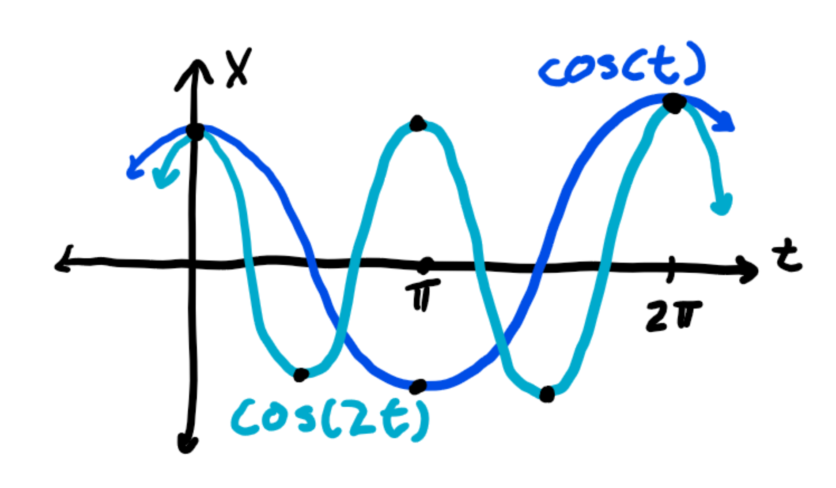
Modified cosine functions
It takes the cosine function 2π before it starts to repeat, so we say it has a period of 2π since it repeats its cycle after this much time has passed.
The normal cosine function cos(t) has a period of 2π, but cos(ωt) goes by ω times as fast, so it has a period of 2π/ω.
For example, cos(2t) has a period of π since it takes half the time before the graph repeats.

Slide 13
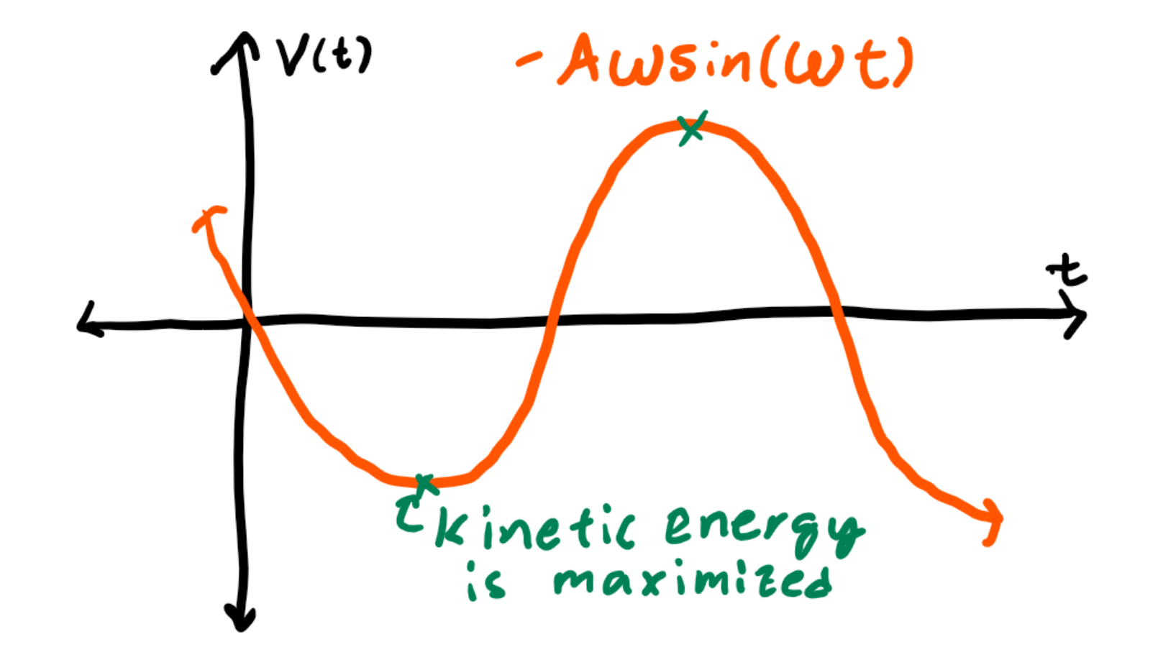
Velocity
We know the derivative of position gives velocity, so if we take the derivative of the position function: x(t) = Acos(ωt), we get v(t) = -Aωsin(ωt).
Notice that the maximum velocity is Aω. In circular motion, A = r, so maximum velocity is rω = v.
Maximum kinetic energy is thus ½ mv², or ½ mA²ω².

Slide 14
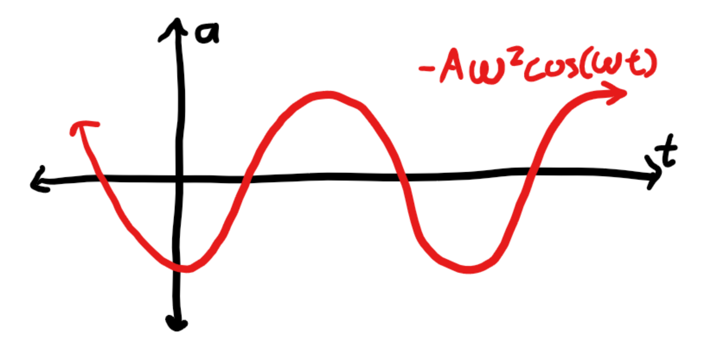
Acceleration
We take the derivative of the position function to get a(t) = -Aω²cos(ωt).
By Hooke’s law, F = -kx = ma.
Let’s plug in the equations we have for a(t) and x(t): -kAcos(ωt) = m[-Aω²cos(ωt)] rearranging into k=mω².
Thus, ω = sqrt(k/m).

Slide 15
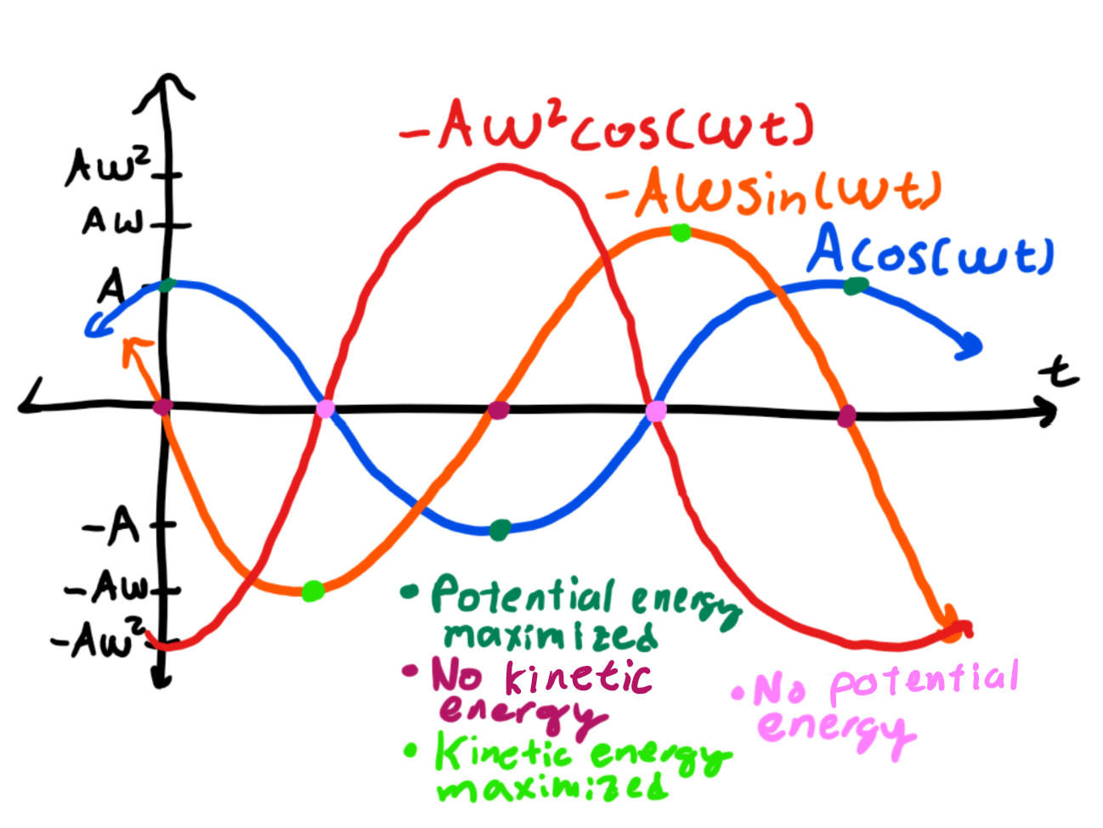
More graphs
Note how the acceleration is maximized when position is furthest from equilibrium, but the velocity is zero there.
Instead, velocity is maximized when position and acceleration are both zero.
Thus, potential energy is maxed out when the spring is fully stretched (kinetic energy is zero) but kinetic energy is maxed when the spring is non-stretched out (potential energy is zero.

Slide 16
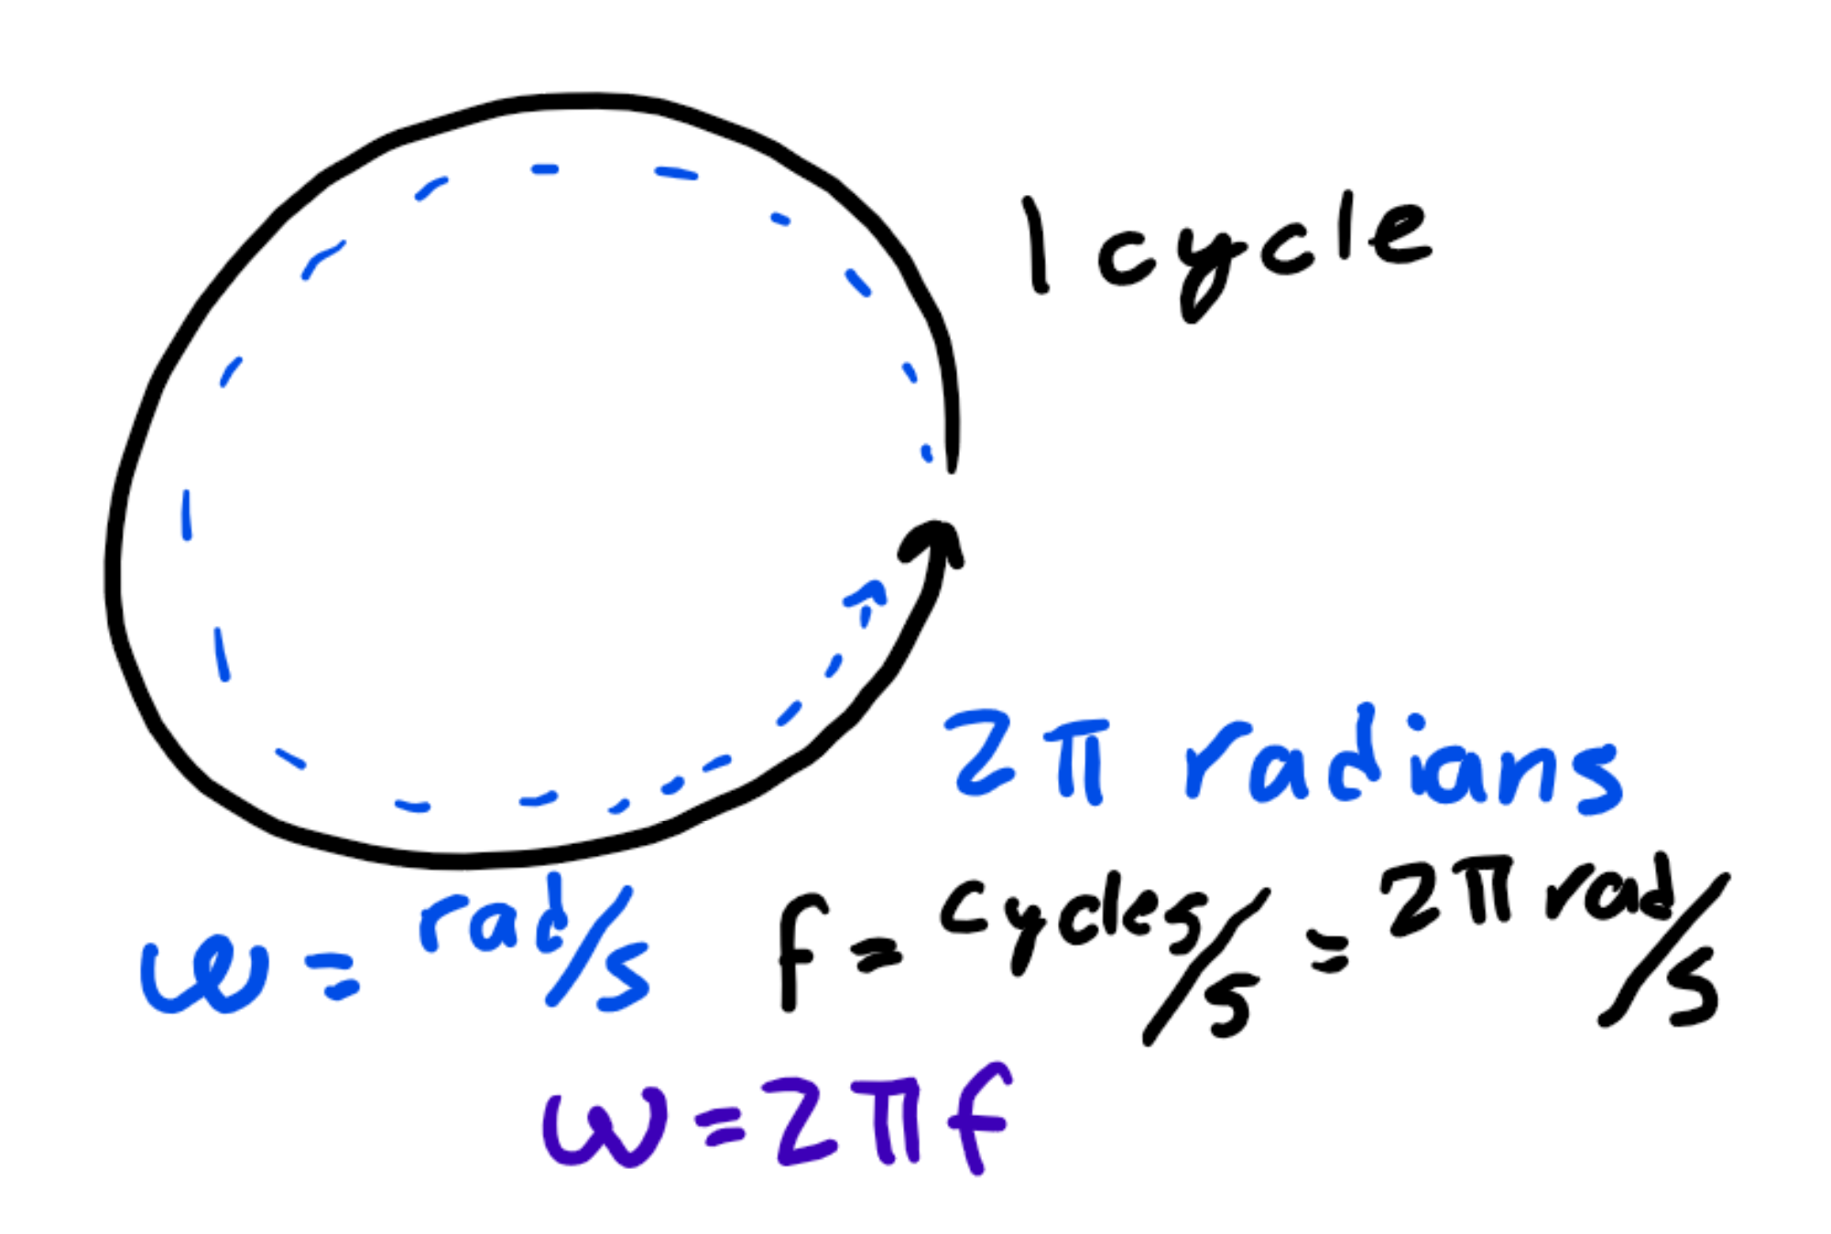
More definitions
Angular velocity, ω, is how many radians an object travels per second, but what if we wanted to know how many cycles it traveled in a second?
We call the amount of cycles per second frequency, represented f, and it also has units 1/s, or Hertz (Hz).
Since there are 2π radians in a complete cycle, f = ω/(2π).

Slide 17
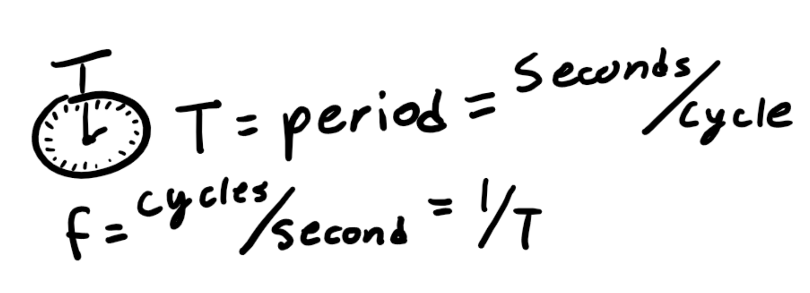
Even more definitions
Period, symbolized T, is how long it takes to complete a cycle, measured in seconds.
Since frequency is cycles per second and period is seconds per cycle, the period is the inverse of frequency, so that means T = 1/f.
Thus, T = 2π/ω.

Slide 18
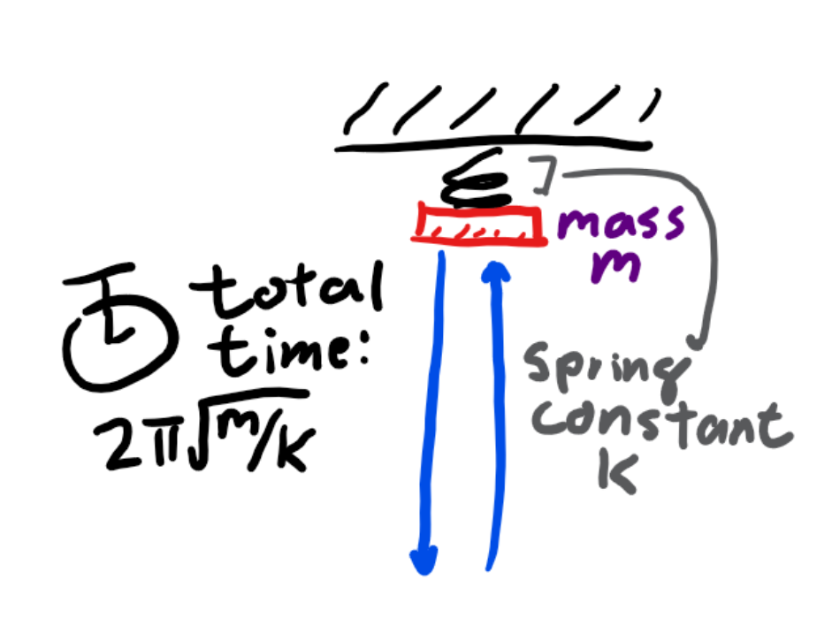
Frequency and period of a spring
Since ω = sqrt(k/m), and f = ω/2π, that means f = sqrt(k/m)/(2π).
Period is the inverse, so the period of a spring oscillation is T = 2πsqrt(m/k).

Slide 19
Simple pendulum

Slide 20
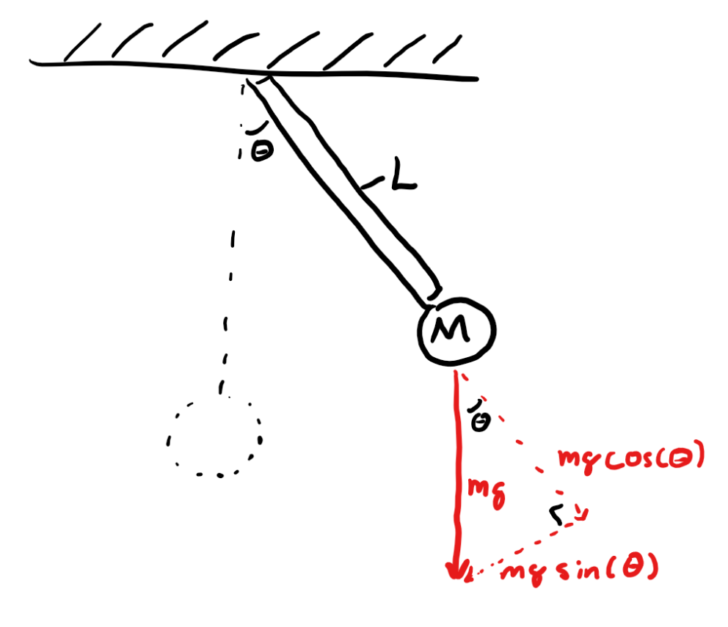
Forces on a pendulum
A simple pendulum is a mass m held a distance L away from the pivot.
When the pendulum is θ away from the rest position, -mg acts on it, but -mgcos(θ) pulls on the string.
We assume the tension of the string counteracts that part of the force, so the only force acting on the pendulum is -mgsin(θ).

Slide 21
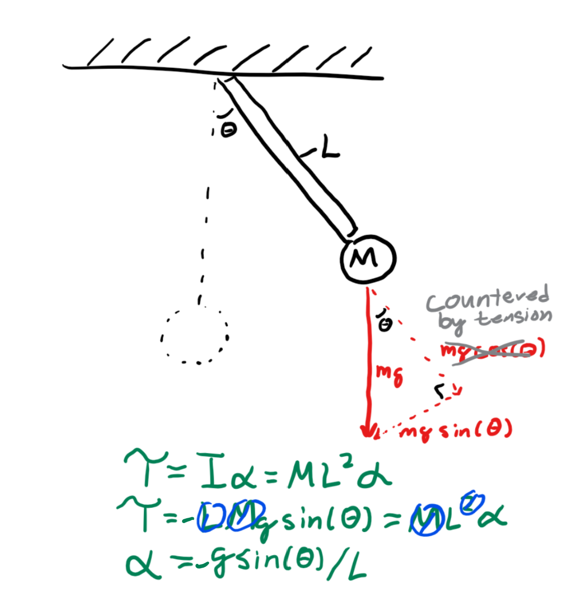
Torque on a pendulum
Since this force acts perpendicularly to the string, it is a torque, and we know that Τ = Iα.
I for a point mass is mL² and we know that rF = T = -Lmgsin(θ), and plugging this in gives -Lmgsin(θ) = mL²α.
Rearranging gives α = -gsin(θ)/L. Since α is also d²θ/(dt)², we get a differential equation d²θ/(dt)² = -gsin(θ)/L.

Slide 22
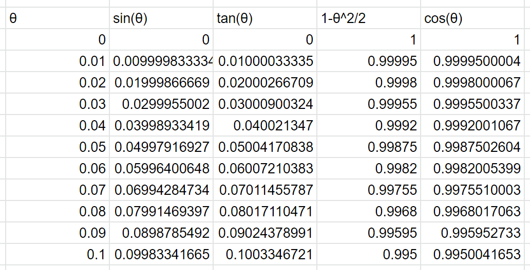
Small angle approximation
If you plug in a few values for sin(θ) for very small values of θ, you’ll notice that sin(θ) ≈ θ.
You’ll also notice that for cos(θ), small values will be approximately 1 - θ²/2, and for tan(θ), small values are also approximately θ.
What is considered “small” is around 15 degrees, or π/12 radians.

Slide 23
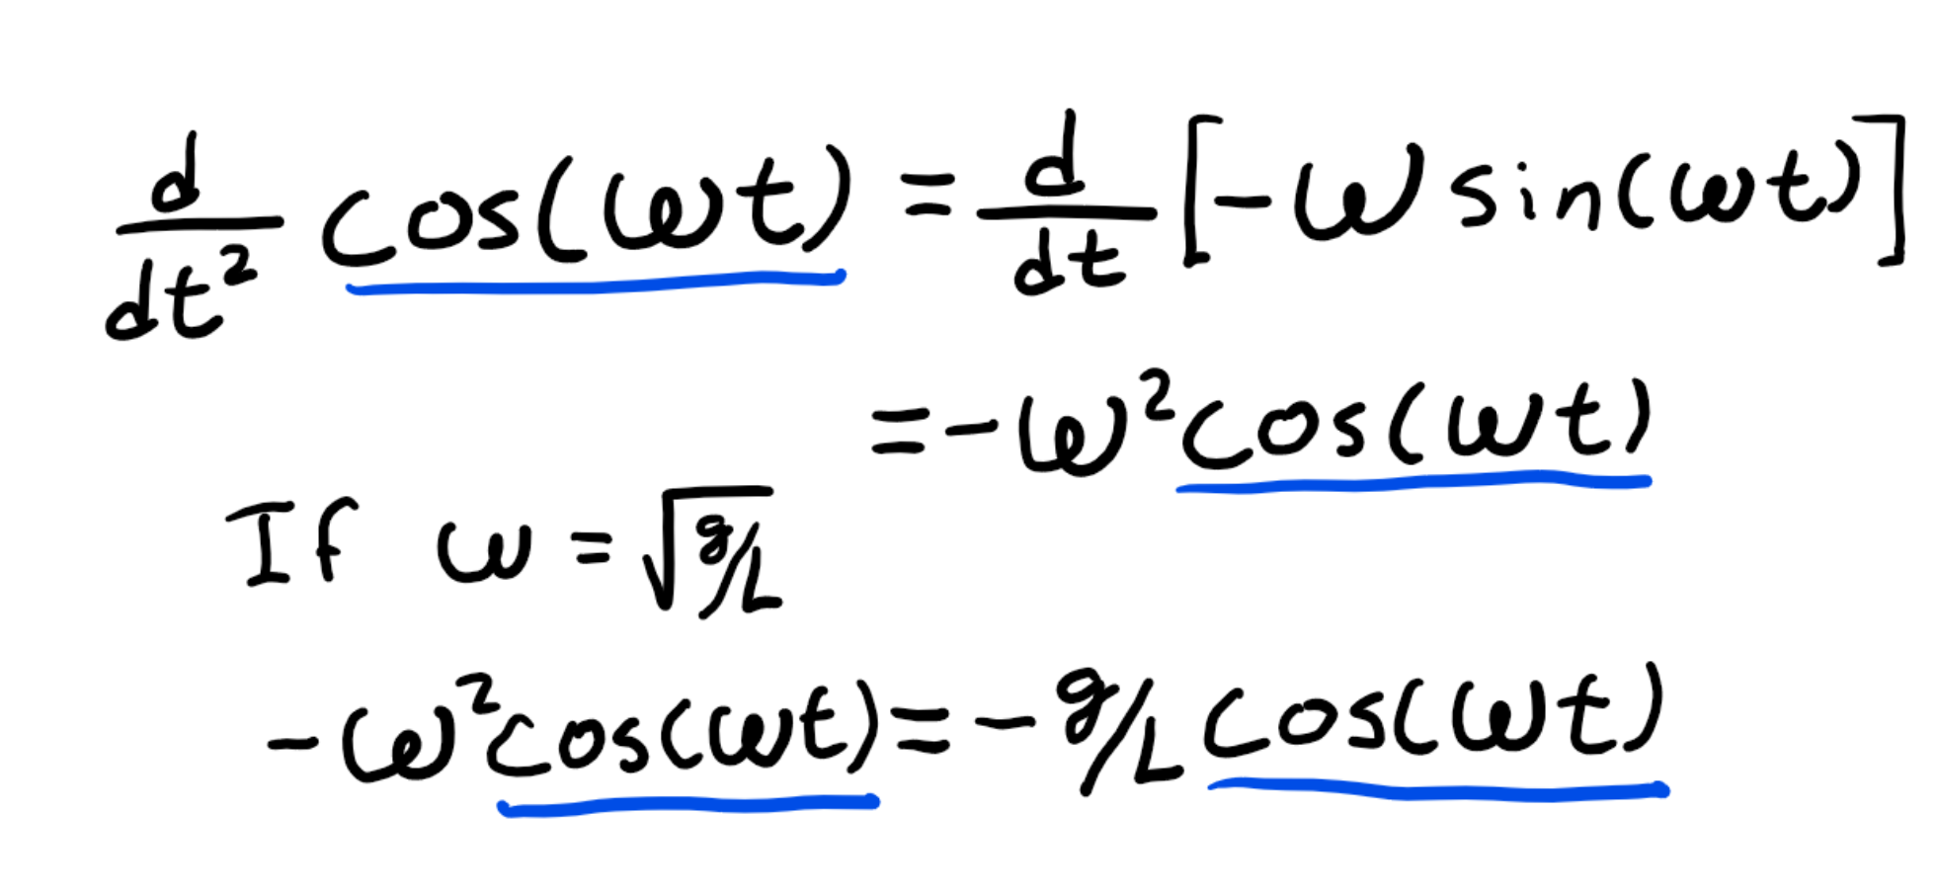
Differential equation
Using the small angle approximation, we get d²θ/(dt)² = -(g/L)(θ).
So we need to find some function whose second derivative is the negative of itself times g/L.
Wait, the θ(t) = cos(ωt) thing’s second derivative was -ω²cos(ωt), so if ω² = g/L, this would work out.
Thus, ω = sqrt(g/L), so T = 2πsqrt(L/g).

Slide 24
Physical pendulum

Slide 25
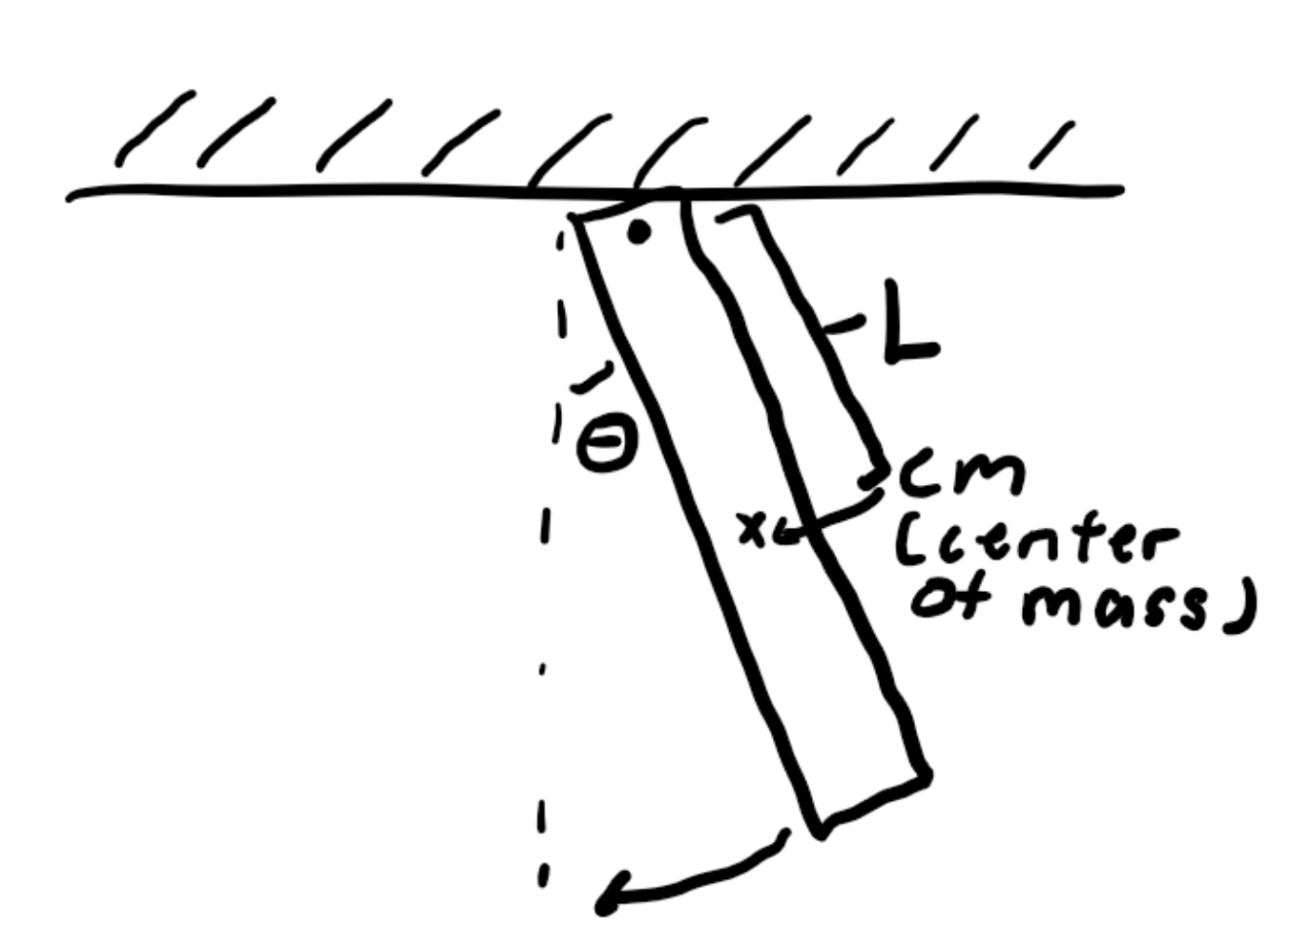
Terminology (aka definitions)
A physical pendulum is just any item being rotated from some pivot point.
We can imagine the center of mass as the point of pivoting, so L will not be the length of the pendulum but the distance the center of mass is from the pivot.
I will represent the moment of inertia at the center of mass.

Slide 26
Equation
We can write the same T = -Lmgsin(θ) equation as before where T = Iα.
Thus, α = d²θ/(dt)² = -Lmgsin(θ)/I.
The solution is again θ(t) = cos(ωt) but this time ω = sqrt(mgL/I), so we can find the period to be T = 2πsqrt[I/(mgL)].

Slide 27
Kepler’s laws (non-simple/harmonic motion)

Slide 28
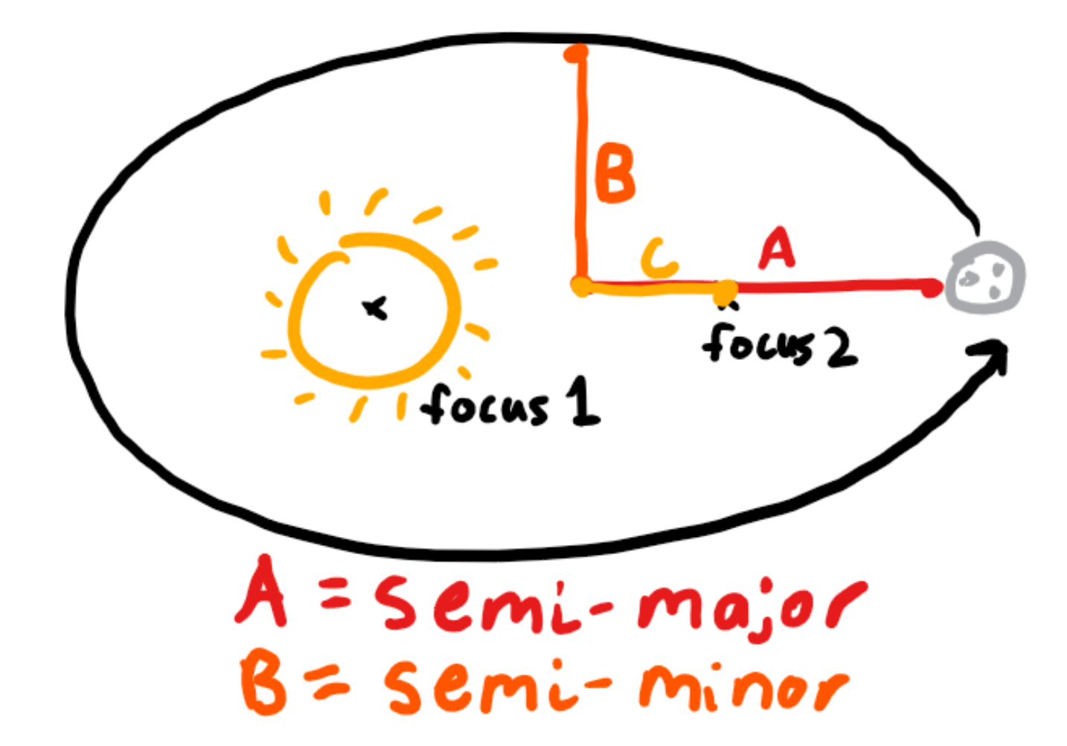
First law
A planet orbits its sun in an ellipse with the sun on one of the foci of the ellipse.
We can say there are two axes to the ellipse: the longer one, the semi-major axes that pass through the foci, and the semi-minor one, perpendicular to the foci.
We say the length of the semi-major is A, semi-minor is B, and the distance a focus is from the center is C.
A focus is defined such that A² - B² = C².

Slide 29
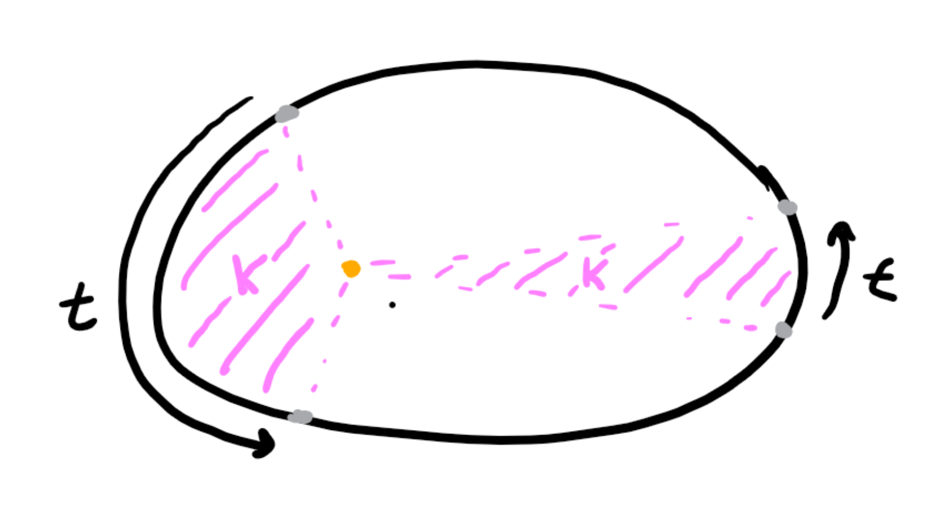
Second law
Let’s draw a line from the planet to the sun and let it sweep out a pizza shape in a certain amount of time t. Let’s say the area of that piece is K.
Like simple harmonic motion, the planet moves faster the closer it is from the sun, but faster the further away it is (conceptually, this is because gravitational force further away).
In fact, this works out so well that for any pizza made in a time t, the area swept out will always be K.

Slide 30
Third law
T = nsqrt(A³) for some constant n. In other words, T² is proportional to A³.
Let’s say a planet orbiting with a semi-major axis of A is struck so its new semi-major axis is 4A.
If the old period was T = nsqrt(A³), the new period is nsqrt[(4A)³] = 8nsqrt(A³).
Thus, the new period is 8 times as long as the old one since n is a constant.

